Slide 1
Crop Production Analysis in India
By Madhav Seth

Slide 2
Objective of the project:
To gain an understanding of crop production in various Indian states and districts. Insights include the production-to-area ratio, the percentage of land captured by each crop season, and the crops produced in India.
To learn more about the top states based on crop season, top crops with the highest average area and production. These insights will assist stakeholders in determining which crops have the highest yield in which state or district and in making appropriate decisions to maximise economic benefits.

Slide 3
Data sharing agreement:
Sample File Name (ex. crop_production.csv)
Length of Data Stamp (8 digits)
Length of Time Stamp (6 digits)
Number of columns
Column Name
Column Data Type

Slide 4

Architecture

Slide 5
Data Overview
The Data includes single .csv file with all examples, ordered by date( Year 1997 to Year 2015).
The Number of Instance - 246091 for crop_production.csv
Number of attributes – 7 attributes

Slide 6
KPIs - Key Performance Indicator
Key indicators show a summary of the Crop Production area and production data based on various parameters- .
Crops Producing States of India.
Crop Producing districts of India.
The year of crop production.
Season under which crops fall.
Names of the crop produced in India.
Area cultivated under each crop (in Hectares).
Total production quantity of a crop (in Tons).

Slide 7
Insight Summary
There are total 33 Crop Producing states and union territories in India.
In the 33 Crop Producing states and union territories there are total 646 crop producing districts in India.
There are total 124 crops which are produced in India.
There are total 6 seasons under which crops are produced in India viz. Summer, Winter, Whole Year, Kharif , Rabi and Autumn.

Slide 8
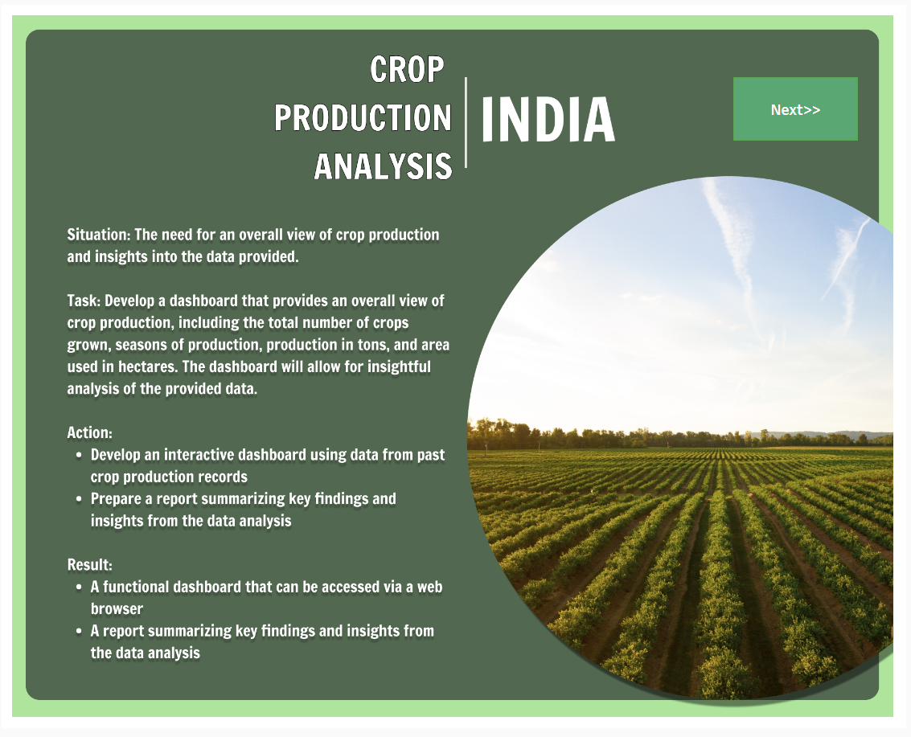
Dashboards

Slide 9
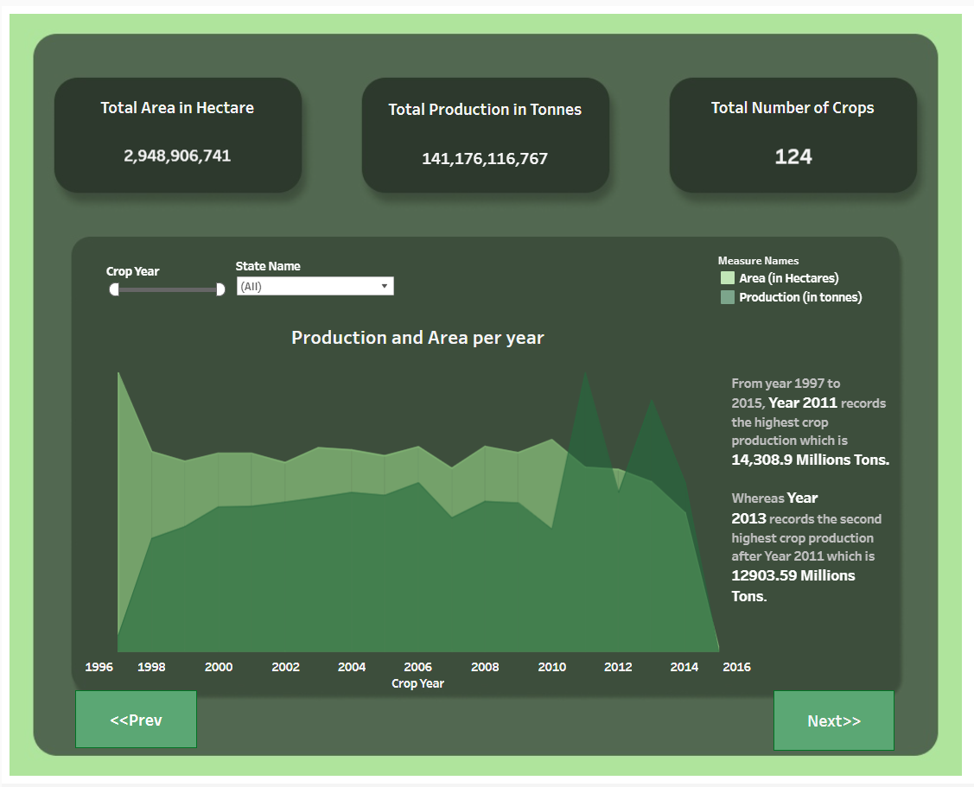

Slide 10
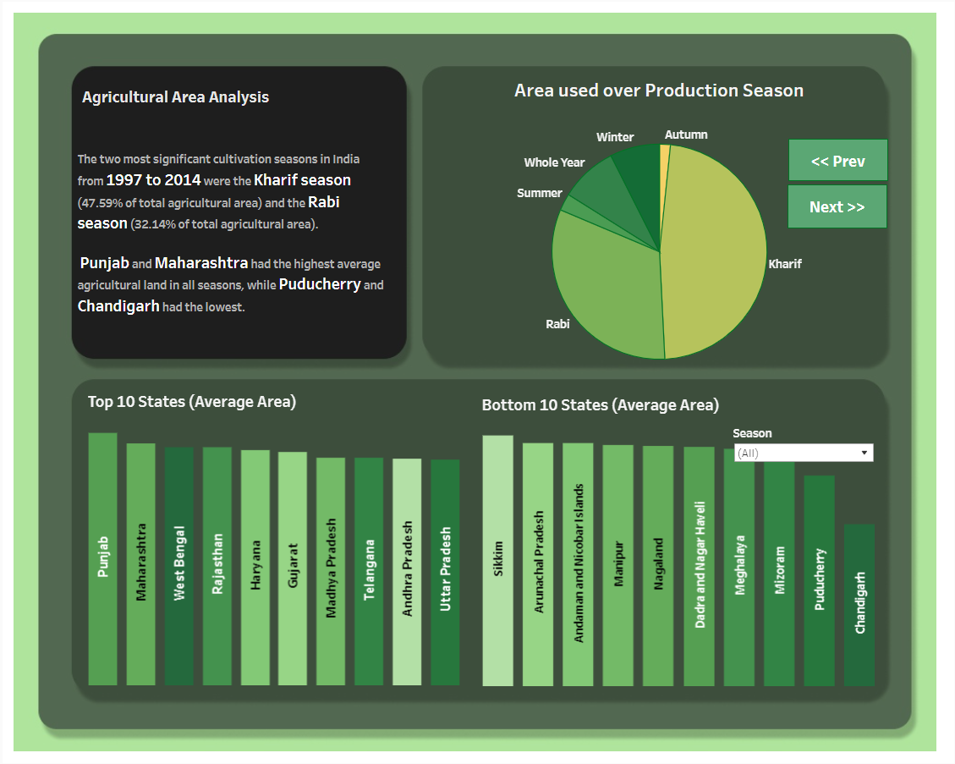

Slide 11
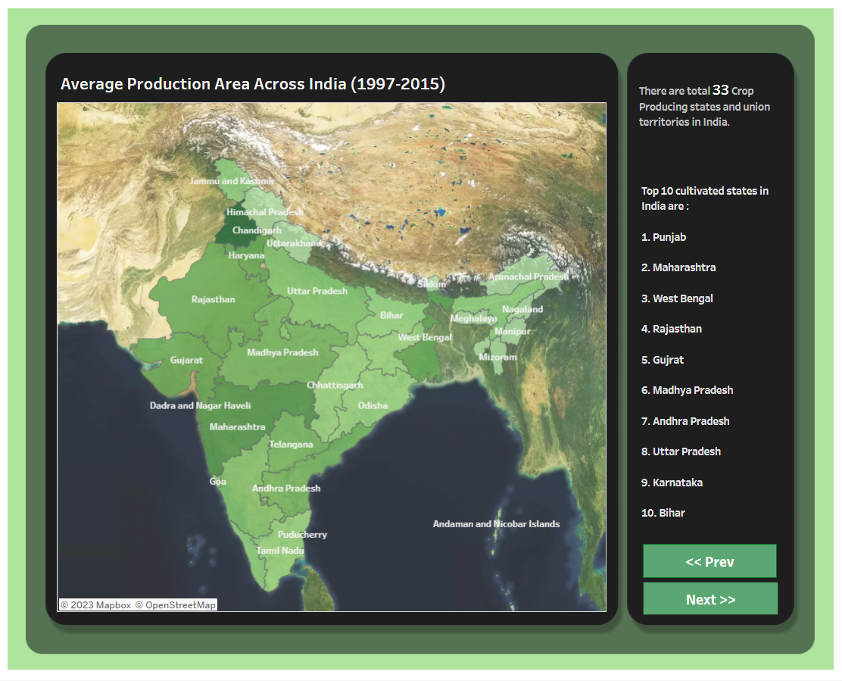

Slide 12
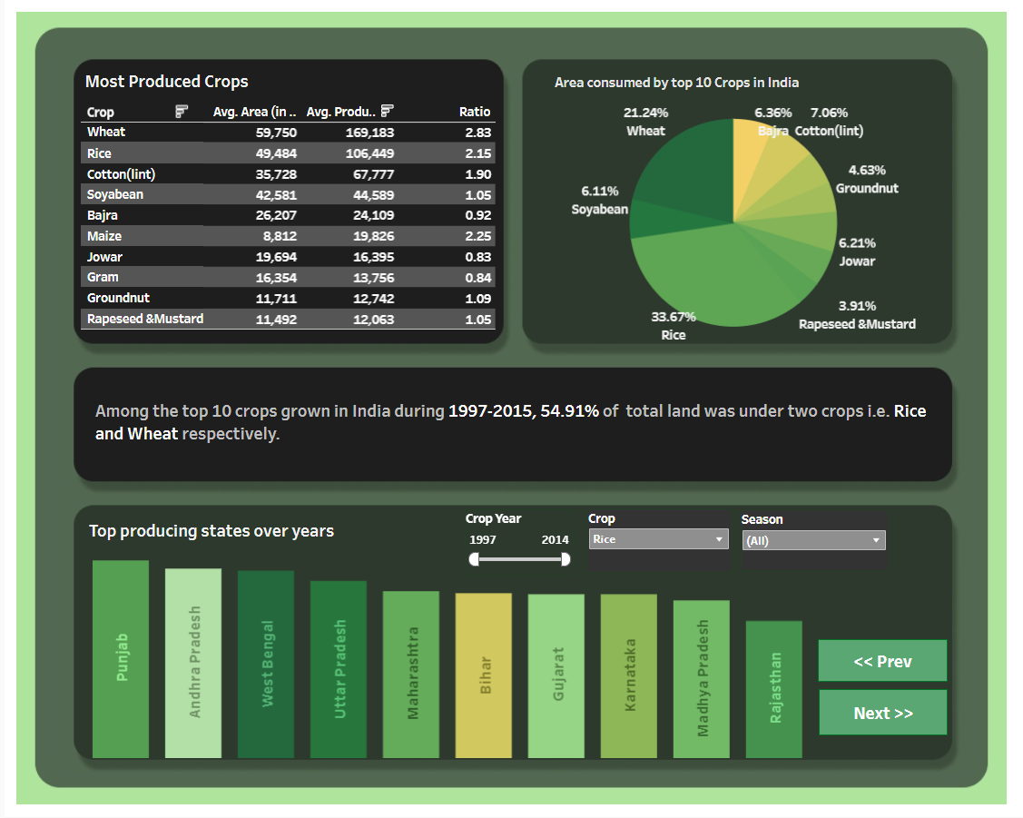

Slide 13
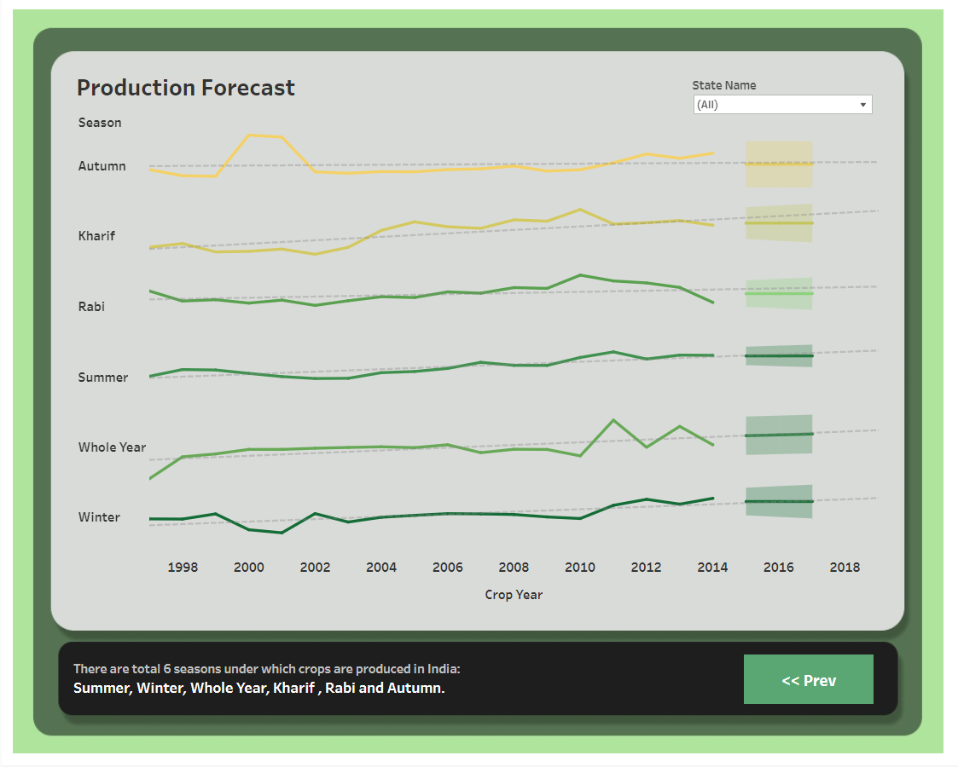

Slide 14
Insight summary:
A total of 2.9 Billion Hectares area is cultivated to date in India.
The total food grain production in the country was recorded at 141.1 Billion Tons.
54.91 % of the Total area of India is under Rice and Wheat.
Among the Top crops grown in India, Rice has the highest percentage of 33.67%.
From the year 1997 to 2015, the Year 2011 records the highest crop production which is 14,308.9 Million Tons. Whereas the Year 2013 records the second highest crop production after the Year 2011 which is 12903.59 Million Tons.

Slide 15
Insight summary:
47.56% of the Total area cultivated in India is under Kharif Season which shows that the Indian Environment is more suitable for the Kharif crops.
32.14% of the Total area cultivated in India is under Rabi Season which makes it the second highest after the Kharif season.
The Indian environment is least suitable for the growth of crops that falls under the Summer and Autumn Season.

Slide 16
Insight summary:
Top 10 Crops according to average cultivated area are –
1. Wheat 6. Jowar
2. Rice 7. Gram
3. Soyabean 8. Groundnut
4. Cotton 9. Rapeseed and Mustard
5. Bajra 10. Maize.

Slide 17
Thank You

